Slide 1
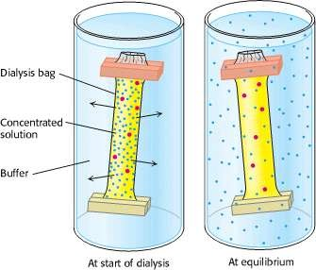
Overview of techniques in protein purification:
i) Structural biology – Tertiary/Quaternary structure of protein molecule
ii) Functional assay
Structure-function correlation ⇒ Functionally active structure of protein
Limitation of molecular spectroscopic techniques in the analysis of protein structure:
Spectroscopic signals are chromophoric group specific not molecule specific
Absorption spectroscopy: peptide bond ⁓ 220nm ; aromatic amino acid residues ⁓ 280 nnn
Fluorescence spectroscopy: Tyrosine and Tryptophan (intrinsic fluorescence)
External flurophore Nuclear Magnetic Resonance: ¹H; ¹³C; ¹⁵N signal
Protein must be purified
Cell lysis (ultra sonication/lysozyme) → lysate → centrifugation to separate membranes
Precipitation of nucleic acids – Strptomycin/Protamine/Polyethyleneimine
Centrifugation to separate nucleic acid pellet
Dialysis (small molecules can pass through the pores of cellulose membranes

Slide 2
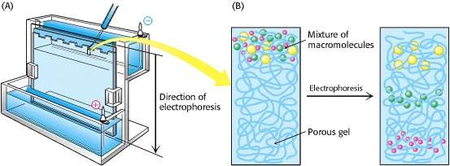
Gel Electrophoresis:
Electrophoresis – Molecules with net charge move in an electric field
⇒ Offers a powerful means of separation
Velocity of migration of protein molecules in an electric field depends on:
Electric field strength (E), Net charge on the protein molecule (z) and Frictional coefficient (f)
Electric force, Ez, driving the charged molecule toward the oppositely charged electrode is
opposed by the viscous drag, fv, arising from friction between moving molecules and medium
Ez
v = --------
f
Electrophoretic separation are carried out in gels which serve as a molecular sieve that enhances separation. Molecules that are small compared with the pores in the gel readily move through the gel, whereas molecules much larger than the pores are almost immobile. Intermediate size molecules move through the gel with various degree of velocity. Electrophoresis is performed in a thin, vertical slab of polyacrylamide. The direction of flow is from top to bottom.

Slide 3
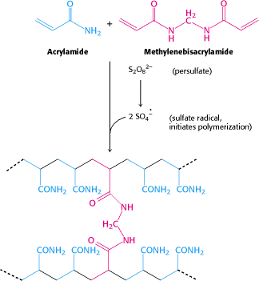
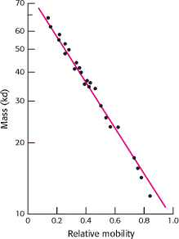
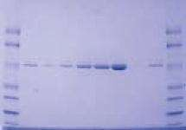
Polyacrylamide gels, formed by the polymerisation of acrylamide and cross-linked by methylenebisacrylamide, are choice supporting media for electrophoresis as it is chemically inert and readily formed.
Proteins are separated on the basis of mass by electrophoresis in a
polyacrylamide gel under denaturing condition:
Mixture of proteins is dissolved in a solution of sodium dodecyl sulfate (SDS), an anionic detergent, to disrupt all noncovalent interactions in the native protein
Mercaptoethanol (2-thioethanol) is added to reduce disulfide bonds
Anions of SDS bind to main chains at a ratio of about one SDS anion
for every two amino acid residues
The complex of SDS with denatured protein has a large net negative
charge that is roughly proportional to the mass of the protein
The negative charge acquired on binding SDS is usually much greater
than the charge of the native protein
Polymerisation is initiated with freshly dissolved ammonium persulfate together with a free radical scavenger, TEMED
The mobility of most of the polypeptide chains under these
conditions is linearly proportional to the logarithm of their mass
Proteins in the gel can be visualized with silver or coomassie blue, which reveals a series of bands
SDSPAGE

Slide 4
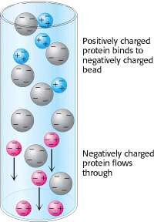
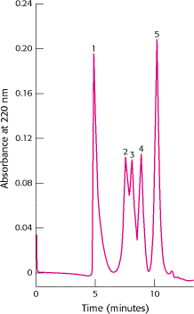
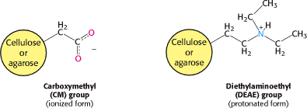
Ion-exchange chromatography:
Proteins can be separated on the basis of their net charge
A positively charged protein binds to a column of beads (stationary phase) containing carboxylate groups whereas a negatively charged protein will not bind
Positively charged proteins (cationic proteins) are separated on a
negatively charged carboxymethyl-cellulose (CM-cellulose) columns
Negatively charged proteins (anionic proteins) are separated on
positively charged diethylaminoethyl-cellulose (DEAE-cellulose column)
Positively charged bound protein can be eluted out of the column by increasing
the concentration of soduim chloride or another salt in
the eluting buffer as sodium ions compete with the
positively charged groups on the protein for binding to the column
Proteins with low density of net positive charge will elute first,
followed by those having high charge density

Slide 5
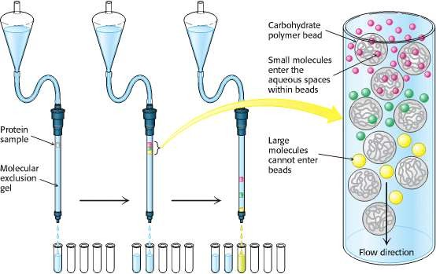
Gel-filtration chromatography:
Proteins are separated on the basis of the size
Sample is applied from top of a column consisting porous beads made of an insoluble but highly hydrated polymer such as dextran or agarose.
Sephadex, Sepharose, Bio-gel are commonly used commercial preparation of these beads, typically 0.1 mm in diameter
Small molecules can enter these beads, but large ones cannot ⇒ small molecules are distributed in the aqueous solution both inside the beads and between them, whereas larger molecules are located only in the solution between the beads
Larger molecules flow more rapidly through this column and emerge first because smaller
volume is accessible to them
Molecules that are of a size to occasionally enter a bead
intermediate position
Small molecules will exit last
will flow from the column at an

Slide 6
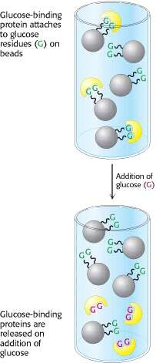
Affinity chromatography:
High affinity of proteins for specific chemical groups
Example: Concanavalin A – has high affinity for glucose Concanavalin A can be purified by passing a crude extract through a column of beads containing covalently attached glucose residues
The bound concanavalin A can be eluted by adding a concentrated solution of glucose that displaces the column- attached glucose residues from binding sites on concanavalin A
Affinity chromatography can be effectively used to isolate a
protein that reconises group X by
(1) covalently attaching X or a derivative of it to a column
(2) adding a mixture of protein to this column, which is then
washed with buffer to remove unbound proteins
(3) eluting the desired protein by adding a high concentration of a soluble form of X or the condition to decrease binding affinity

Slide 7
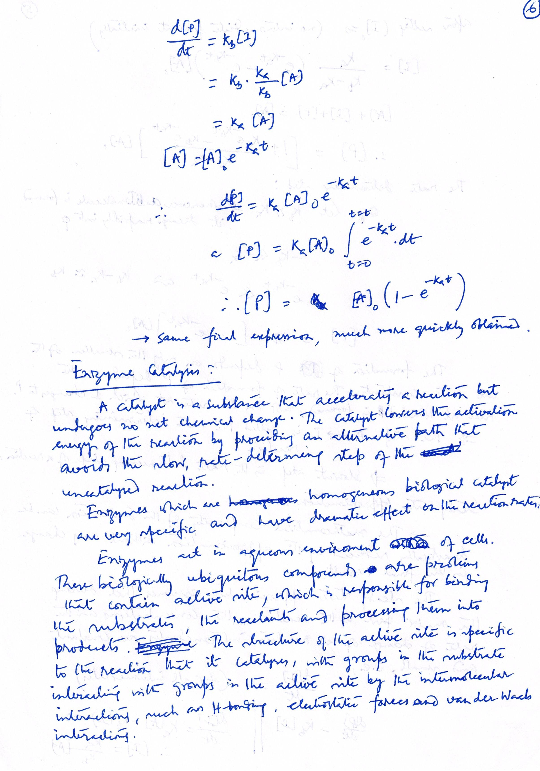
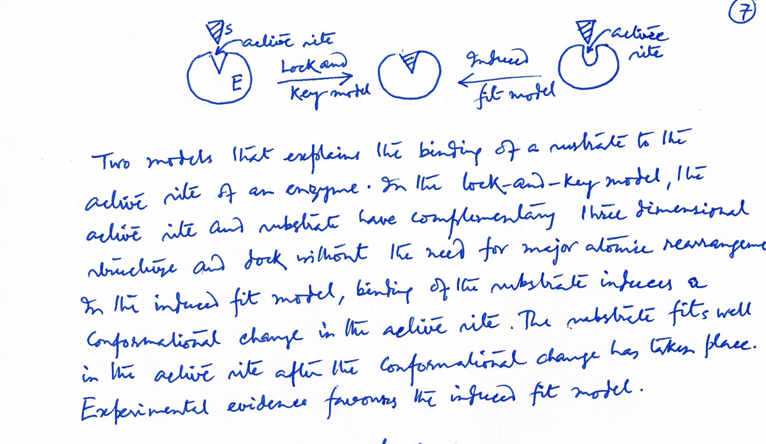

Slide 8
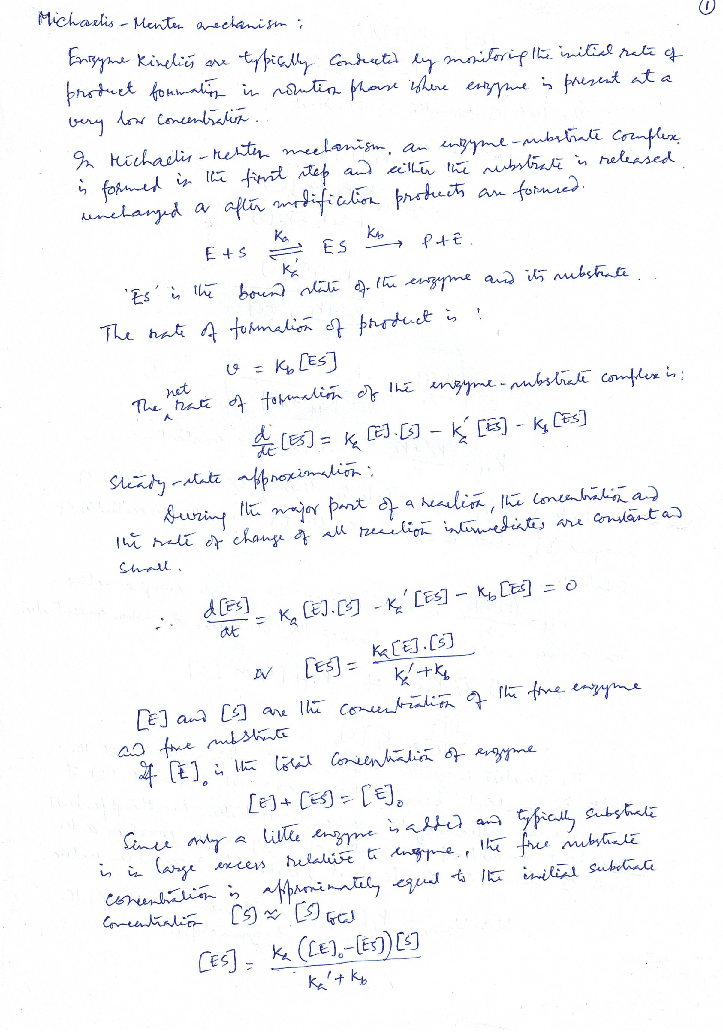

Slide 9
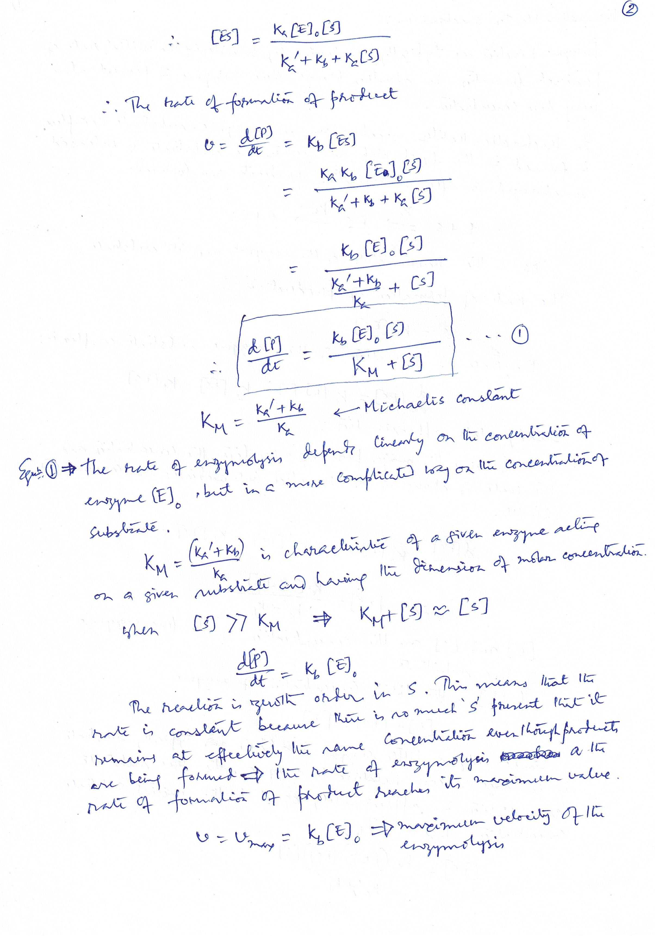

Slide 10
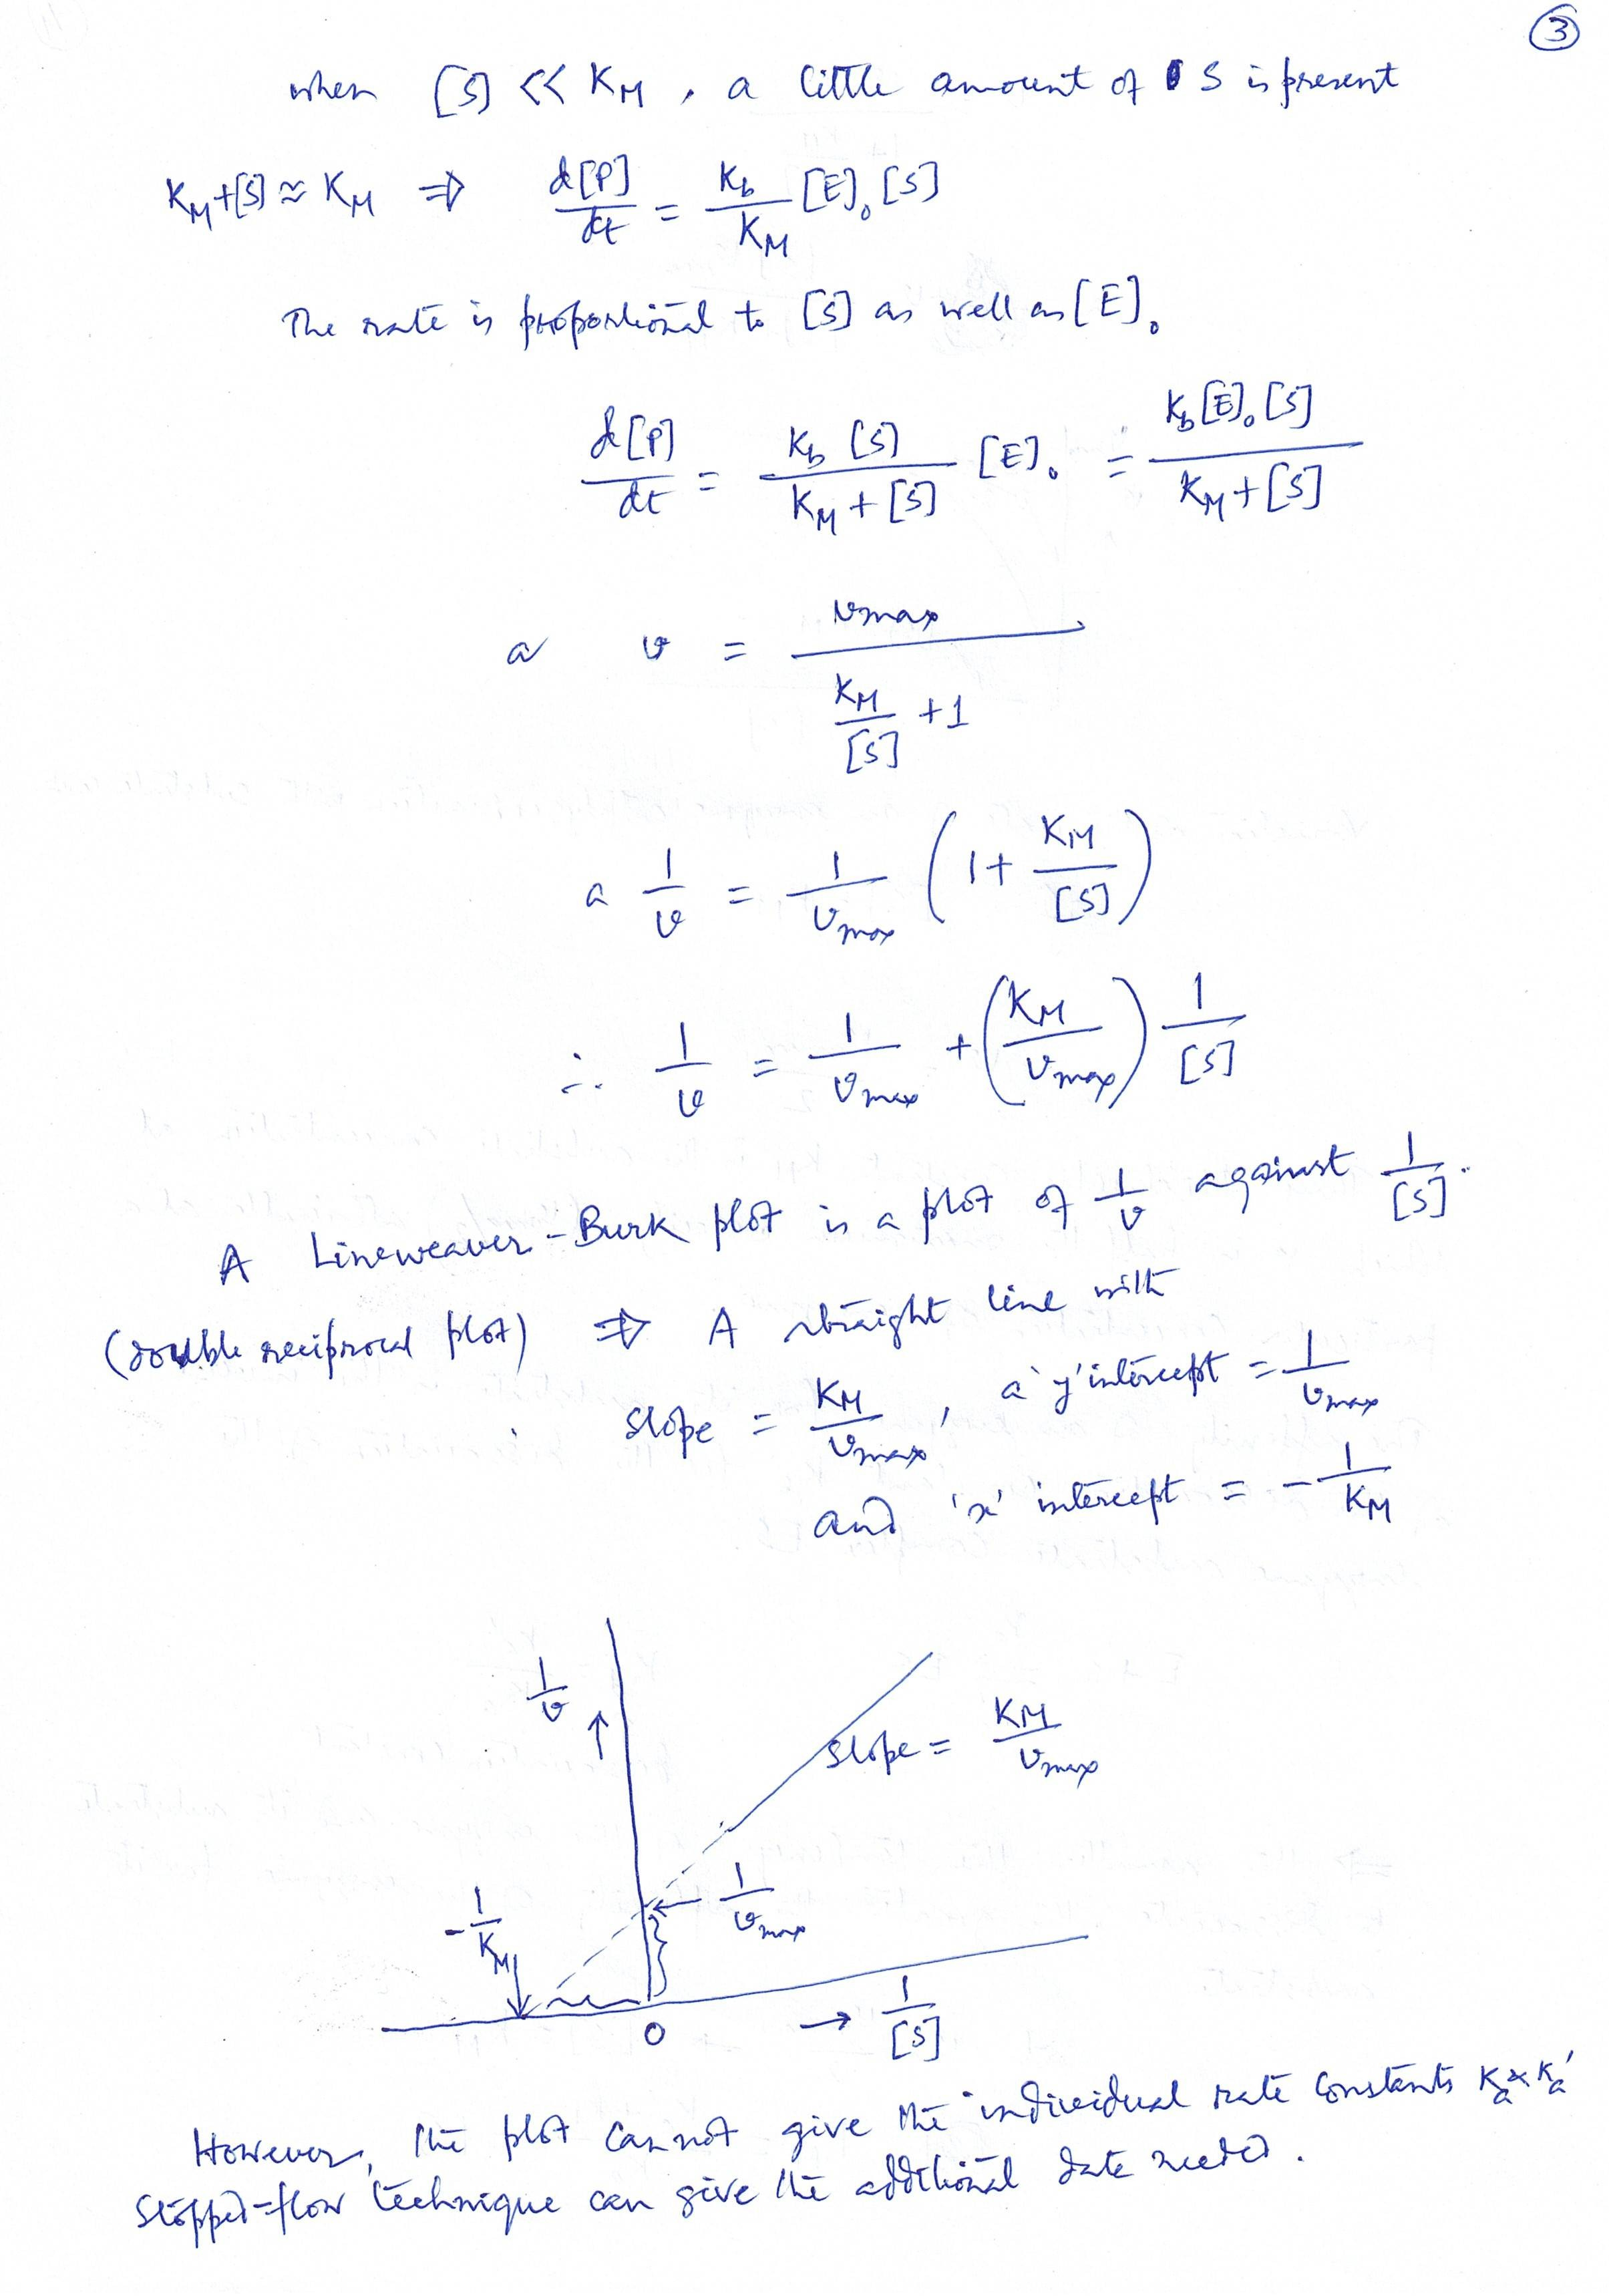

Slide 11
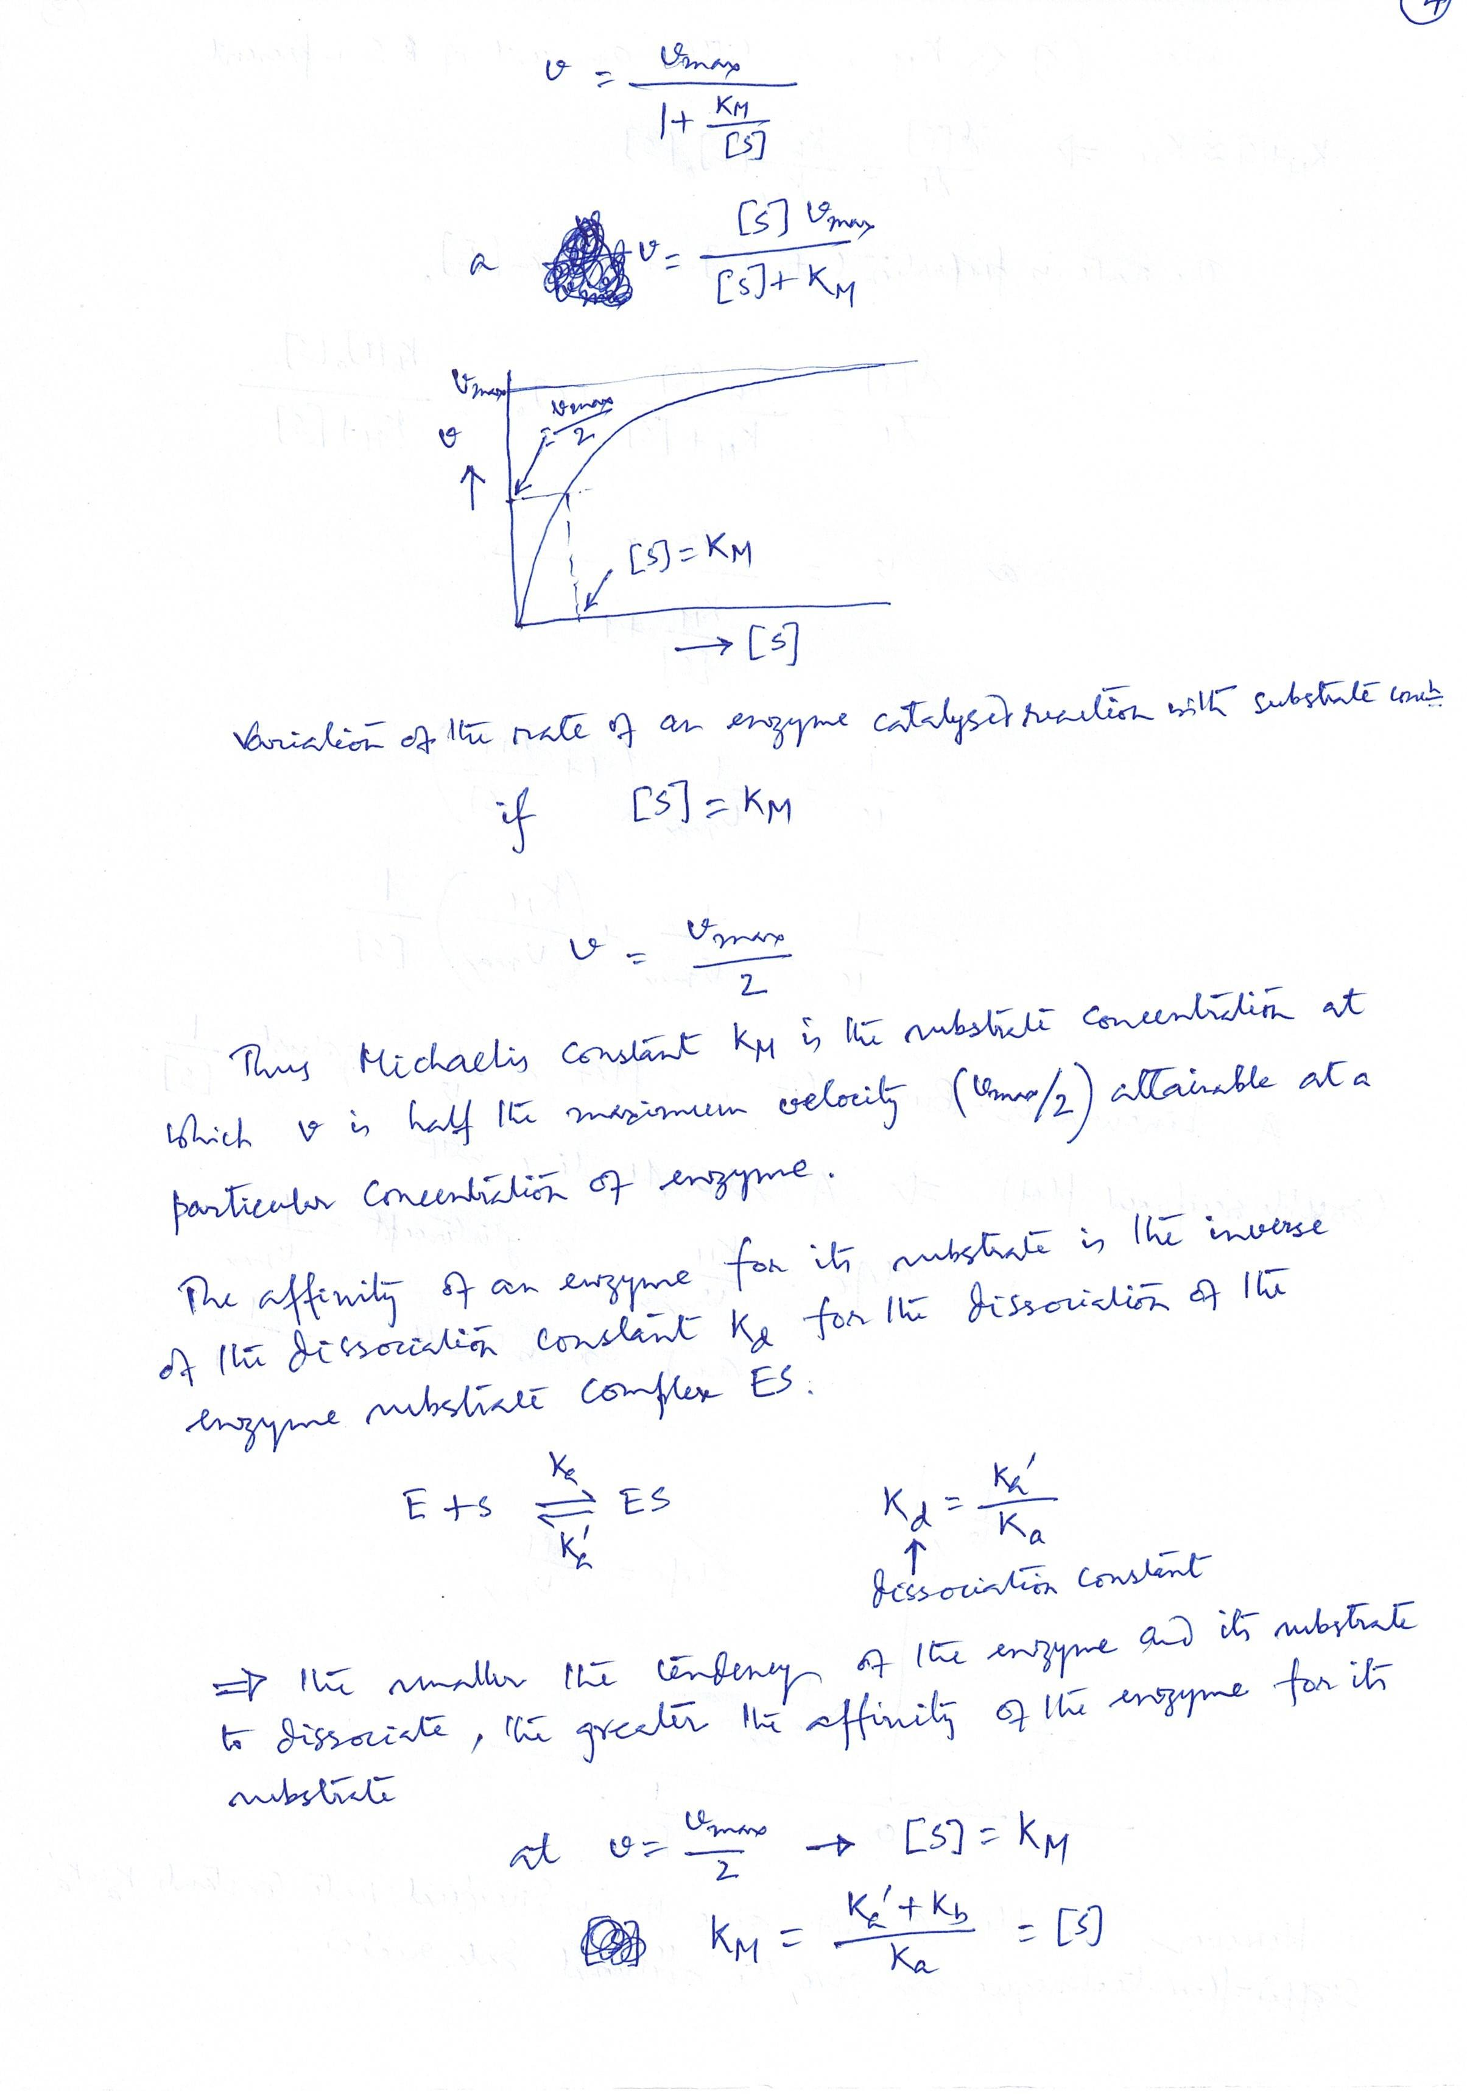

Slide 12
